Slide 1
A Deep Learning Approach to Network Intrusion Detection Using Stacked AutoEncoder
By
RajaKumaran.M(201504071)
Vasantha kumar.A(201504115)
Shyam.R(201504095)
Guided By,
B.SelvaKumar M.E.,(Ph.d) AP/CSE
Department of CSE
Notes:
1
1
1
1

Slide 2
Objective
Outcomes
To device a better model using deep learning techniques in network intrusion detection .
Accuracy of Attack classification is improved compared to the existing system.
Proposed Technology
Modules
Data Preprocessing in NSL KDD data set
Nonsymmetric Deep AutoEncoder
Decision Tree Classifier
Stacked AutoEncoder
Department of CSE

Slide 3
EXISTING SYSTEM

Slide 4
Literature Survey
Title | Network Anomaly Detection: Methods, Systems and Tools
Author | Monowar H. Bhuyan, D. K. Bhattacharyya, and J. K. Kalita
Publication Year | 2014
Feature Selection | Subset Generation Complete Heuristic Random Subset Evaluation Score Entropy Correlation Consistency Detection Accuracy Validation Simulation Real World Implementation

Slide 5
Literature Survey(Contd)
Title | Network Anomaly Detection: Methods, Systems and Tools
Network Anomaly Detection Methods | Statistical Parametric Non-Parametric Classification Based Clustering and Outlier Based Soft Computing GA based Fuzzy set ANN Based Rough Set Ant Colony AIS Knowledge Based Combination Learners

Slide 6
Literature Survey
Title | A Deep Learning Approach to Network Intrusion Detection
Author | Nathan Shone , Tran Nguyen Ngoc, Vu Dinh Phai , and Qi Shi
Publication Year | 2018
Feature Extraction | Stacked Auto Encoder
Data set | NSL-KDD
Class | 5 Class
Classifier | Random Forest Classifier

Slide 7
Literature Survey
Title | A New Intrusion Detection System Based on Fast Learning Network and Particle Swarm Optimization
Author | Mohammed Hasan Ali , Bahaa Abbas Dawood Al Mohammed, Alyani Ismail , And Mohamad Fadli Zolkipli
Publication Year | 2018
Advantages | It is more efficient where traffic is more because it can run parallel computation
Disadvantages | It is more efficient only when the hidden neurons is increased therefore increase in complexity
Notes:
7
7
7
7

Slide 8
Data Set
The Data set that we use in our proposed system is NSL-KDD data set which is a benchmark data set.
NUMBER OF RECORDS | TRAINING-125974 TESTING-22543
FEATURES | 41
ATTACKS OR CLASS | NORMAL DOS PROBE U2L R2L

Slide 9
ARCHITECTURE

Slide 10
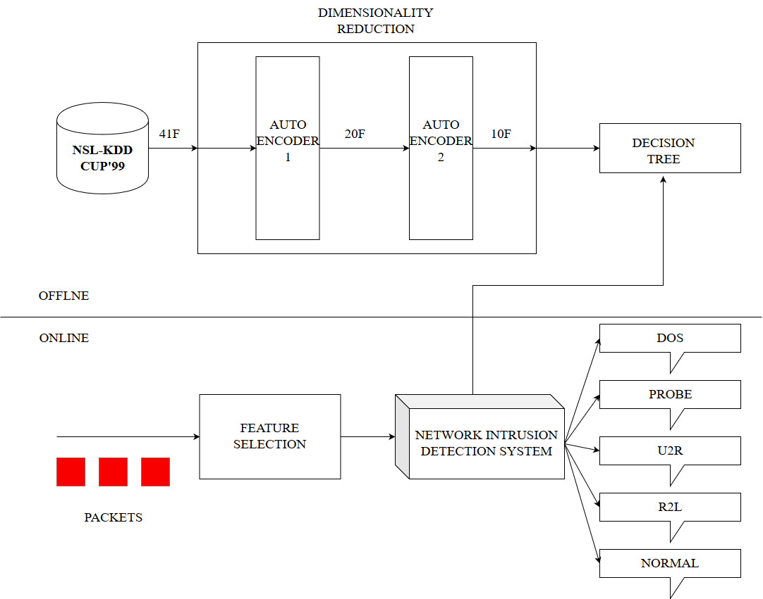

Slide 11
SYSTEM DESIGN

Slide 12
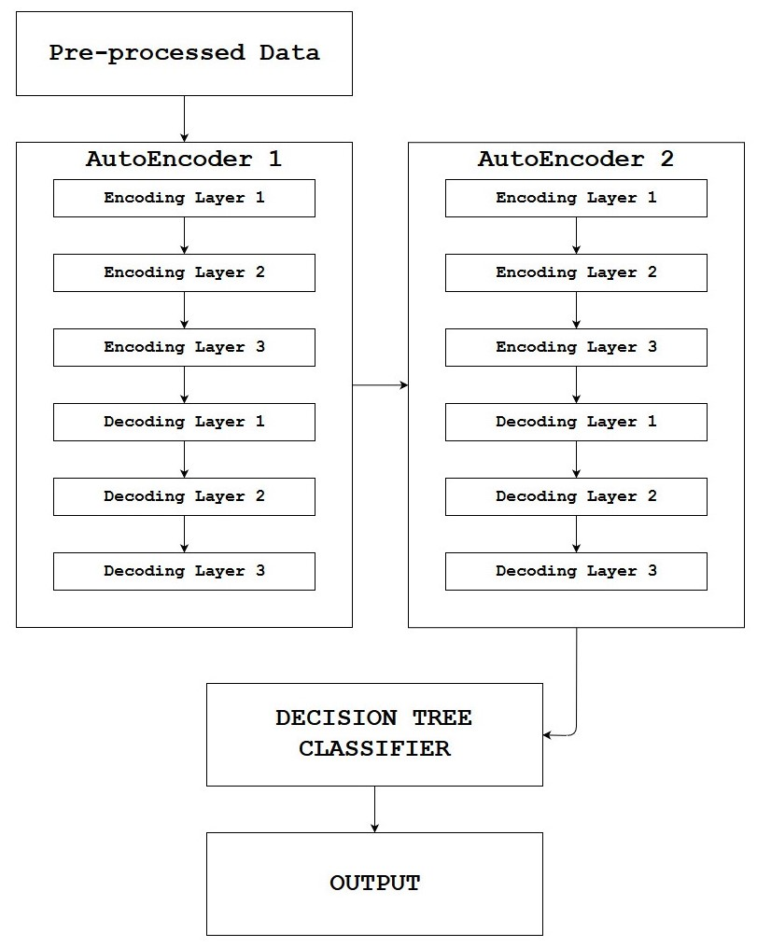
Data Pre-processing

Slide 13
Modules
Data Preprocessing
AutoEncoder(Reduce the Dimension and find new dimension)
Decision Tree Classifier
Department of CSE

Slide 14
Data PreProcessing
The data should be pre processed because there are different variety of data in our NSL KDD data set
Using Labelencoder the feature of type symbolic is converted into continuous value.
Protocal_type
Service
Flag
Label
The other data are having different ranging value so normalizing using Min-Max Normalization

Slide 15
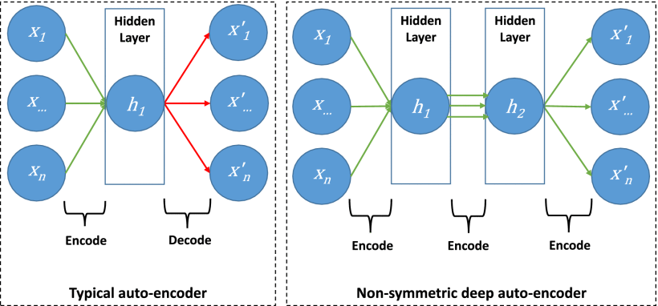
AUTO ENCODER

Slide 16
AUTO ENCODER
The AutoEncoder is a type of neural network
It works in unsupervised manner
The aim of an autoencoder is to learn a representation (encoding) for a set of data, typically for dimensionality reduction.
Learning Function
L(x,y)=∑(x−hW,b(x))
x is the input data
y is the reconstruction

Slide 17
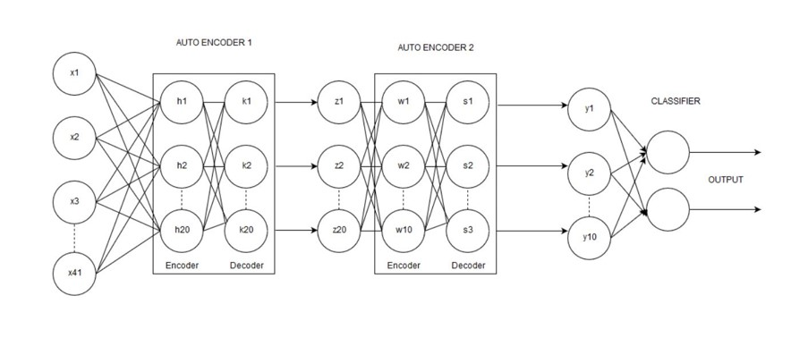
Stacked Auto Encoder

Slide 18
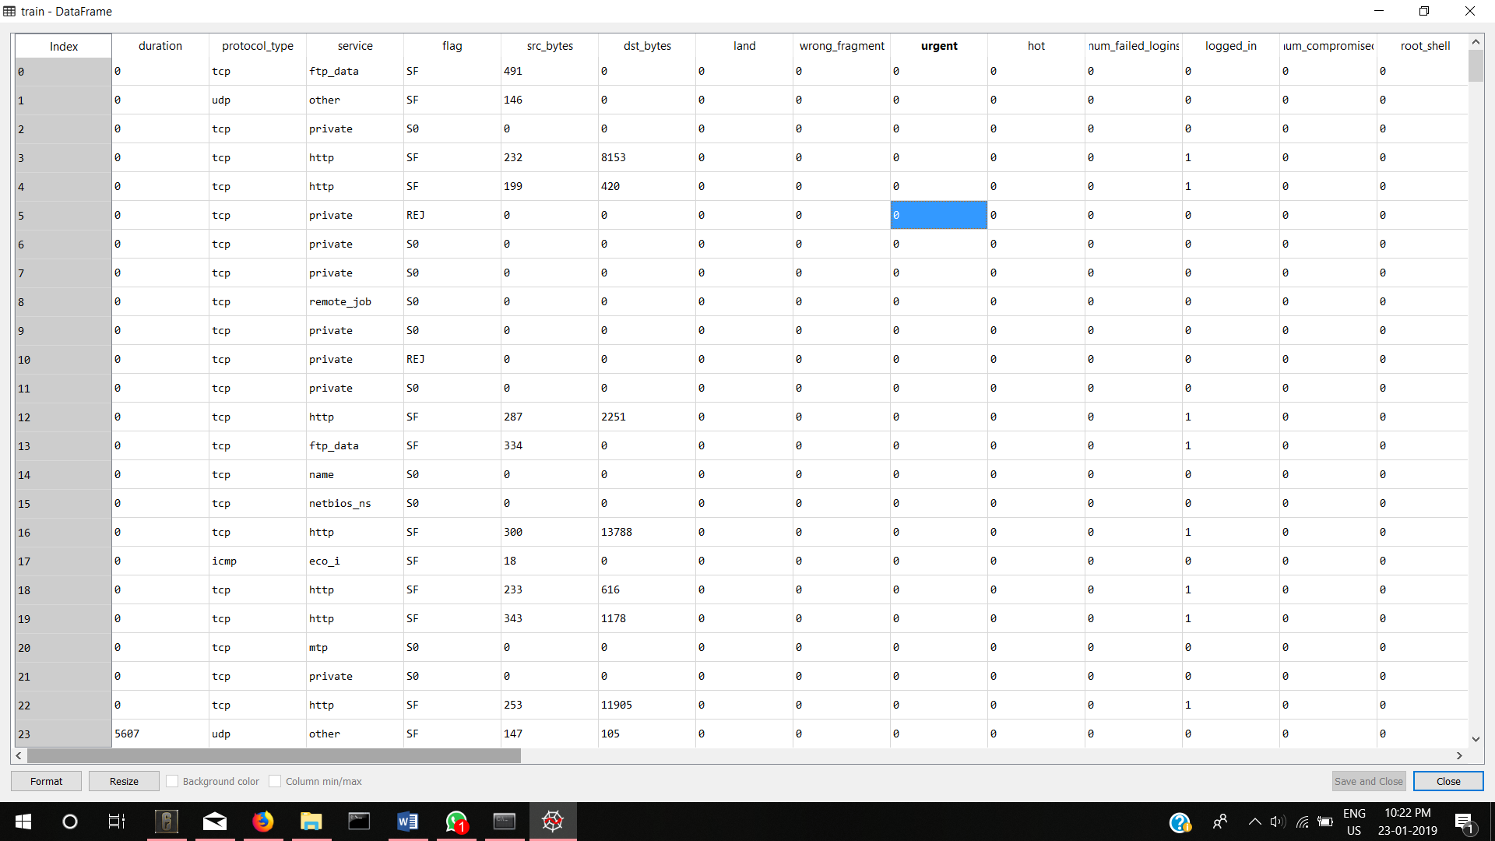
IMPLEMENTATION OF DATA PRE PROCESSING
DATA SET CONTAINS VARIETY OF DATA

Slide 19
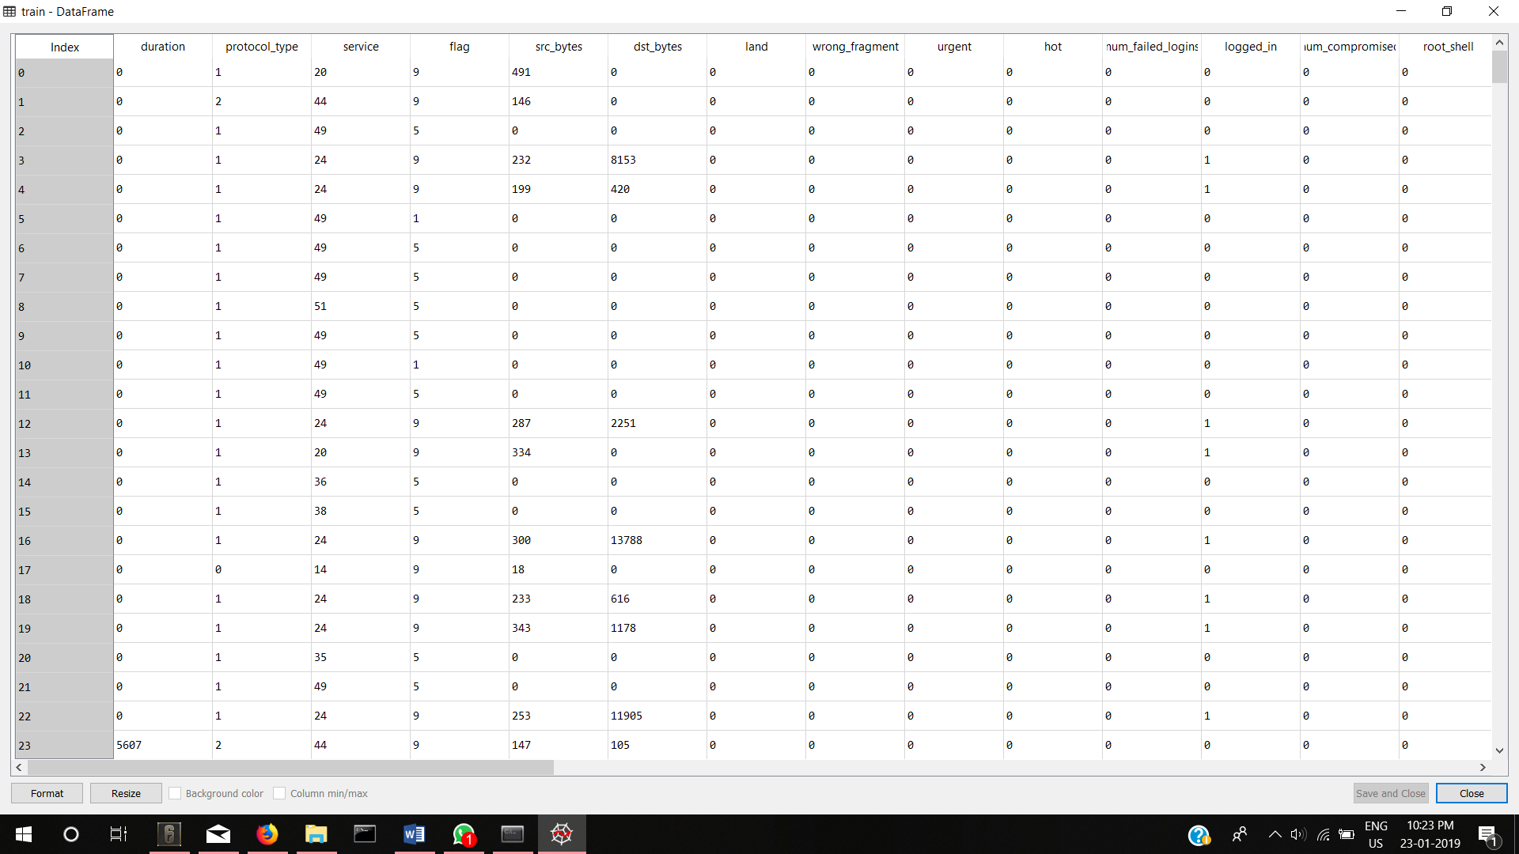
IMPLEMENTATION OF DATA PRE PROCESSING
USED LABELENCODER

Slide 20
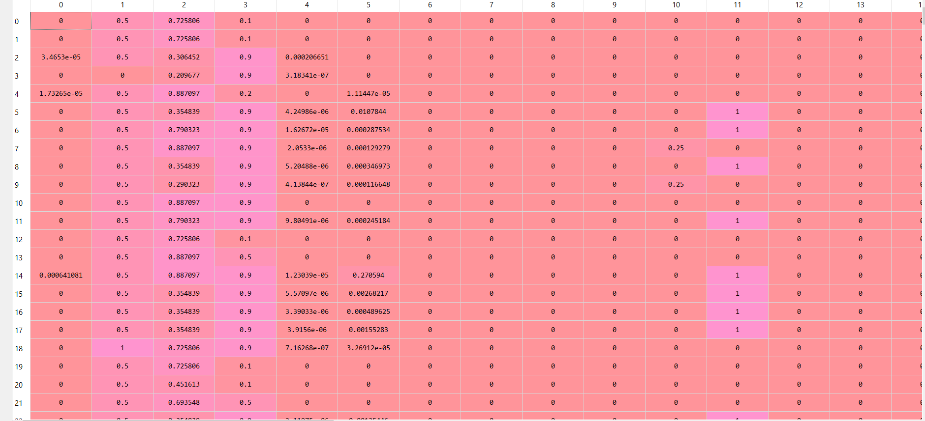
IMPLEMENTATION OF DATA PRE PROCESSING
MIN MAX NORMALIZATION

Slide 21
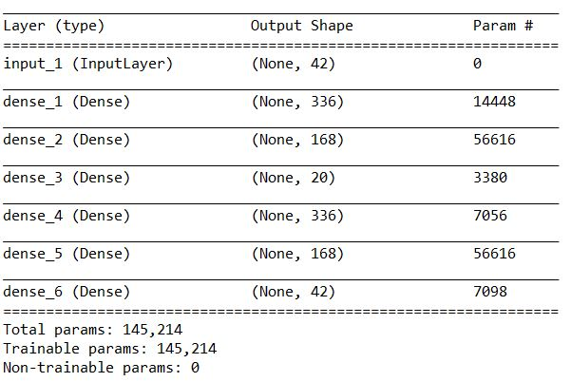
IMPLEMENTATION OF AUTO ENCODER
LAYERS IN AUTO ENCODER

Slide 22
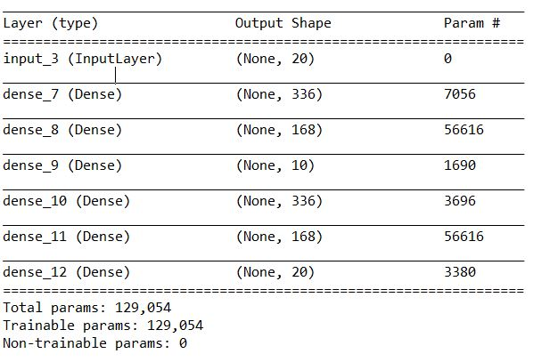
IMPLEMENTATION OF AUTO ENCODER
LAYERS IN AUTO ENCODER

Slide 23

IMPLEMENTATION OF AUTO ENCODER

Slide 24
IMPLEMENTATION OF DECISION TREE
PREDICTED
ACUTAL |  | A | B | C | D | E
 | A | TP_{A} | E_{AB} | E_{AC} | E_{AD} | E_{AE}
 | B | E_{BA} | TP_{B} | E_{BC} | E_{BD} | E_{BE}
 | C | E_{CA} | E_{CB} | TP_{C} | E_{CD} | E_{CE}
 | D | E_{DA} | E_{DB} | E_{DC} | TP_{D} | E_{DE}
 | E | E_{EA} | E_{EB} | E_{EC} | E_{ED} | TP_{E}
CONFUSION MATRIX

Slide 25
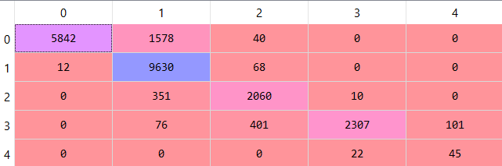
IMPLEMENTATION OF DECISION TREE
CONFUSION MATRIX

Slide 26
OVERALL RESULTS
Accuracy
Precision
Recall
F1 Score
TP+TN
94.6%
TP+TN+FP+FN
TP
78.44%
TP+FP
TP
81.94%
TP+FN
2*TP
78.23%
2*TP+FP+FN

Slide 27
COMPARISON OF PERFORMANCE METRICS

Slide 28
COMPARISON OF METRICS FOR EACH ATTACK OF EXISTING AND PROPOSED METHOD
Accuracy Comparison

Slide 29
COMPARISON OF METRICS FOR EACH ATTACK OF EXISTING AND PROPOSED METHOD
Precision Comparison

Slide 30
COMPARISON OF METRICS FOR EACH ATTACK OF EXISTING AND PROPOSED METHOD
Recall Comparison

Slide 31
COMPARISON OF METRICS FOR EACH ATTACK OF EXISTING AND PROPOSED METHOD
F Score Measure Comparison

Slide 32
Applicability
Economic Aspects
The IDS needs a lot of computing power to work in real time so the cost of development will be very high it also depends on the size of network.
It can be used everywhere where the computer/device is connected to Network/Internet.
Social Responsibility
The main role of the IDS is to predict the anomaly traffic with least information possible and to make the internet a better place and safer than ever.
Department of CSE

